Slide 1

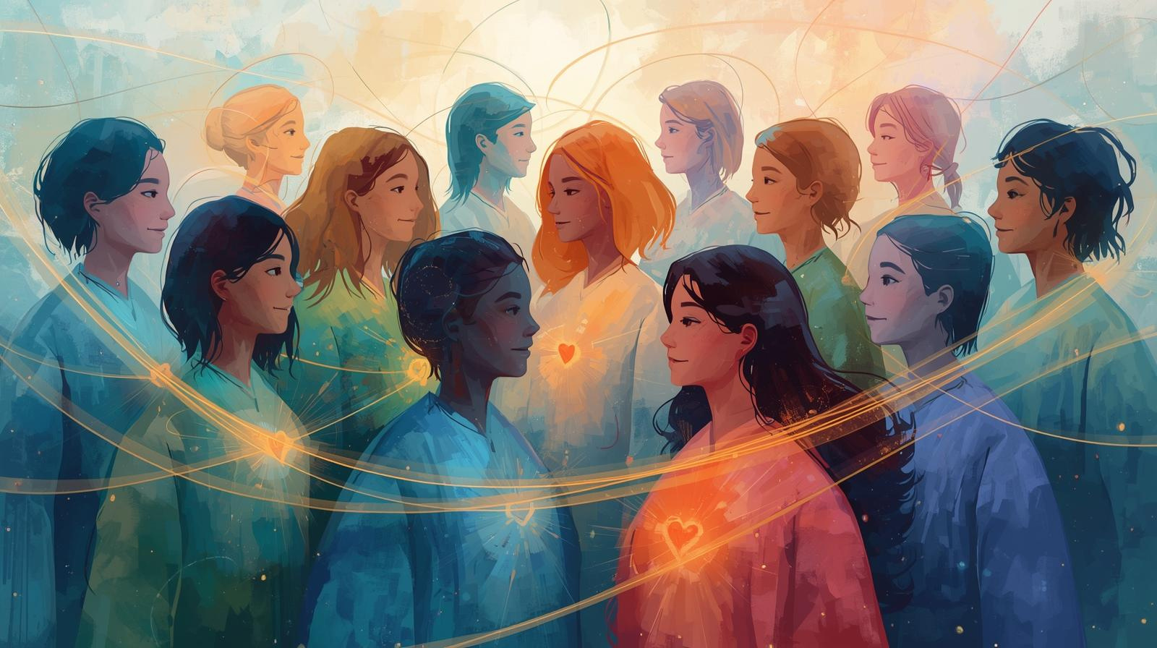

awakin.ai
Can Modern Technologies, Ancient Wisdom and Caring Communties move as one?
Join The Murmuration
November 29, 2025 at 8AM Pacific
PARTNER
awakin.ai/murmur
Insert Logo

